Slide 1
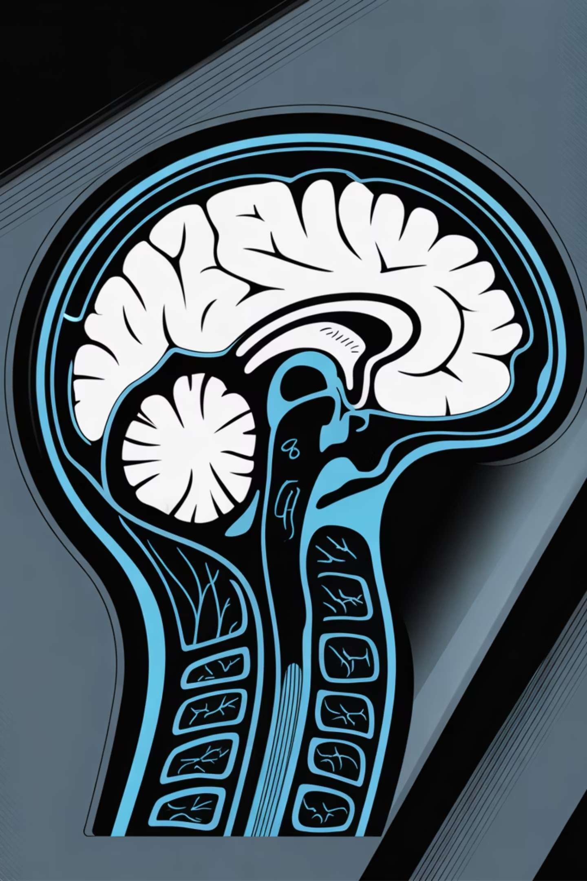
Brain Tumor Segmentation
Using Thresholding and Morphological Operations
21CSE454T – Computer Vision
Student Name: [Add your name]Roll Number: [Add roll number]SRM Institute of Science and Technology

Slide 2

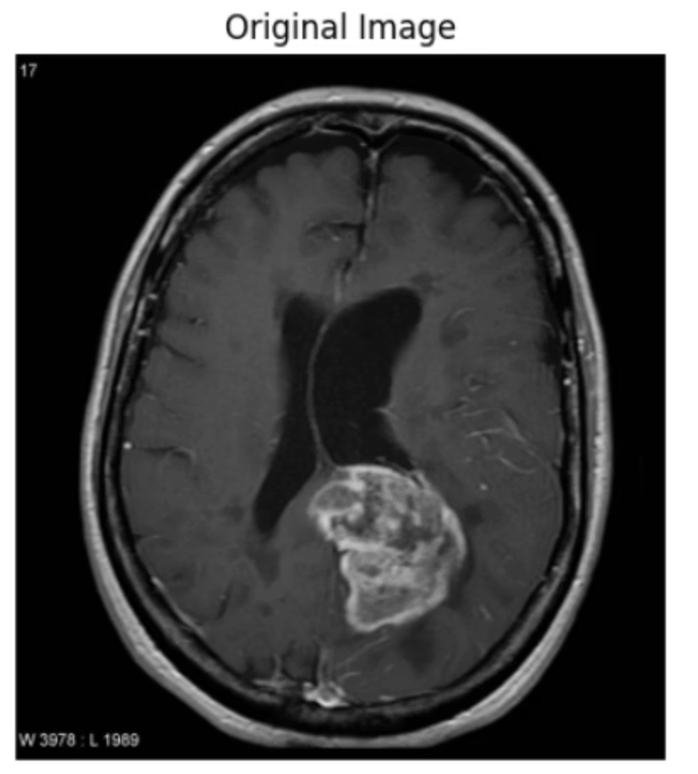
Aim & Objectives
Aim
Key Objectives
Segment tumor regions from Brain MRI images using Otsu's Thresholding combined with Morphological Operations to extract accurate tumor boundaries for medical image preprocessing and analysis.
Convert MRI images to grayscale for standardized analysis
Apply Gaussian blur to reduce noise and artifacts
Use Otsu's thresholding for automated binary segmentation
Refine segmentation using morphological opening and closing
Detect and visualize tumor boundaries precisely

Slide 3
Methodology & Algorithm
Our segmentation pipeline follows a structured sequence of image processing operations designed to isolate tumor regions from surrounding brain tissue.
01
02
03
Grayscale Conversion
Gaussian Blur
Otsu's Thresholding
Convert RGB or color MRI images to grayscale, reducing computational complexity while preserving intensity information needed for analysis.
Apply Gaussian filtering to reduce noise and smooth image details, improving thresholding accuracy and reducing segmentation artifacts.
Automatically determine optimal threshold value to create binary image, separating tumor regions from background based on intensity distribution.
04
05
Morphological Operations
Contour Detection
Apply opening (erosion then dilation) and closing (dilation then erosion) to remove noise, fill holes, and refine mask quality.
Identify and highlight tumor boundaries using contour detection, visualizing segmented regions for medical analysis and validation.

Slide 4
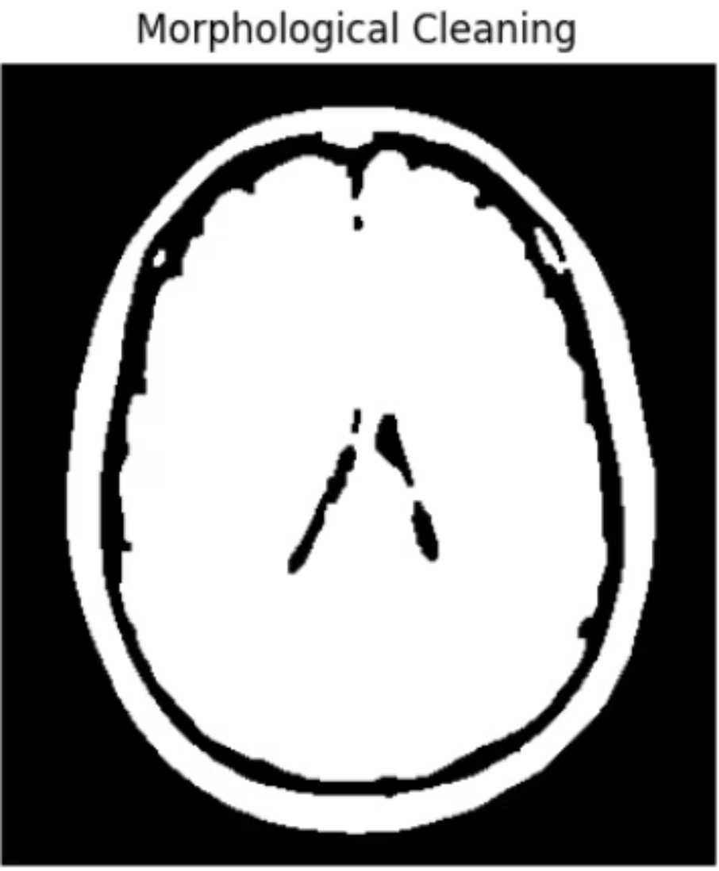
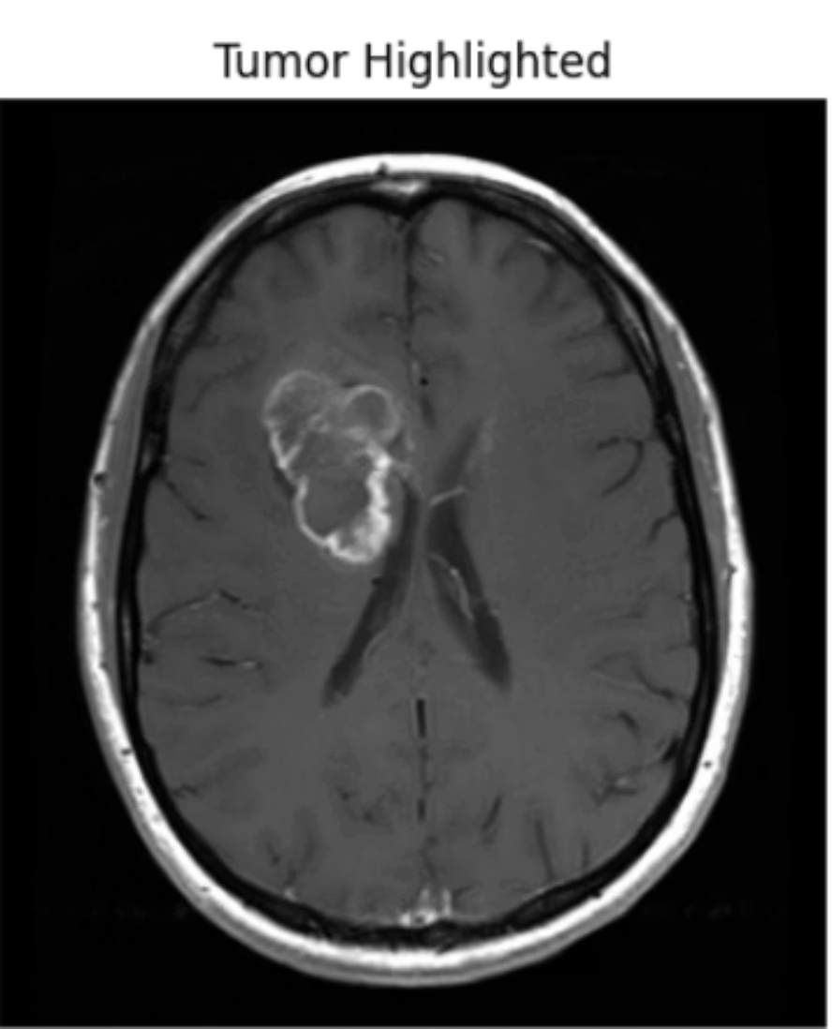
Implementation Details
Tools & Libraries
Dataset Source
Processing Pipeline
Python, OpenCV, NumPy, Matplotlib, Google Colab for implementation and visualization.
Kaggle: Brain MRI Images for Brain Tumor Detection dataset with diverse tumor variations.
Grayscale → Blur → Thresholding → Morphology → Contours
Processing Flow: Raw MRI images undergo sequential operations to extract clean tumor masks suitable for downstream analysis and medical decision support.
After Morphological Cleaning
Tumor Highlighted (Contour Output)

Slide 5
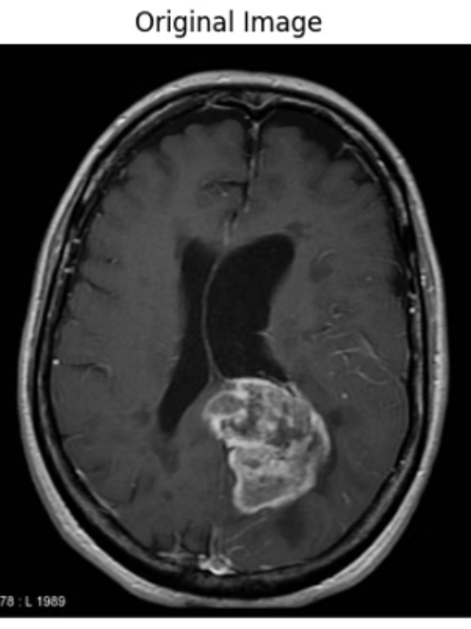
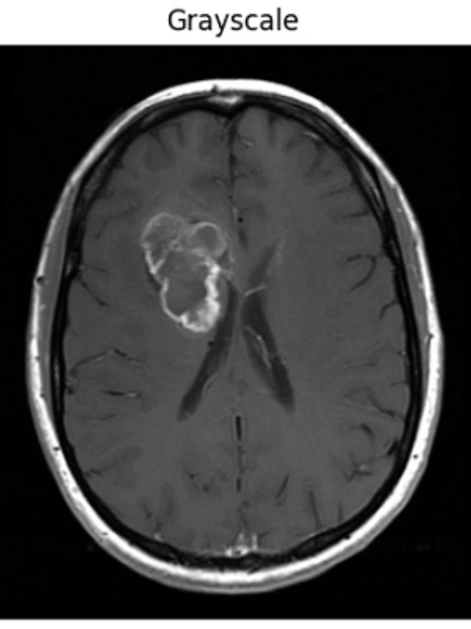
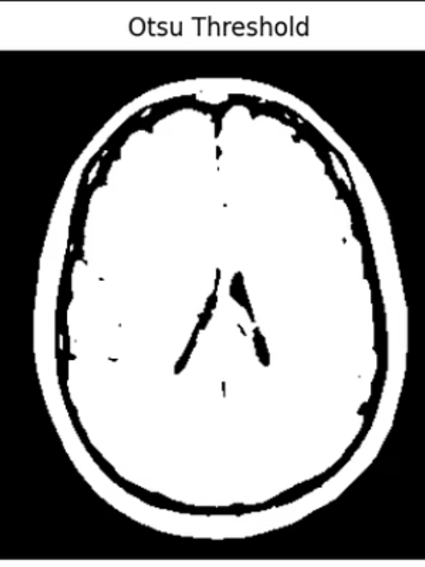
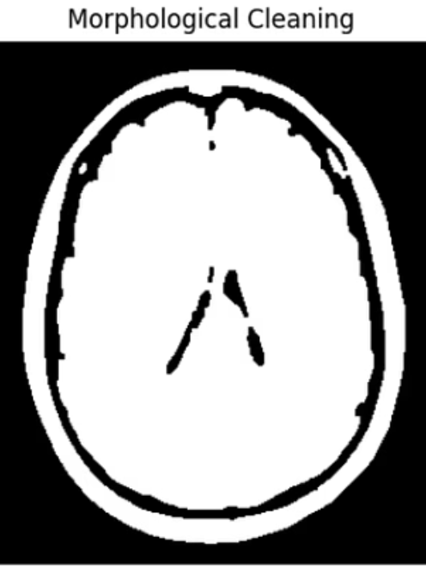
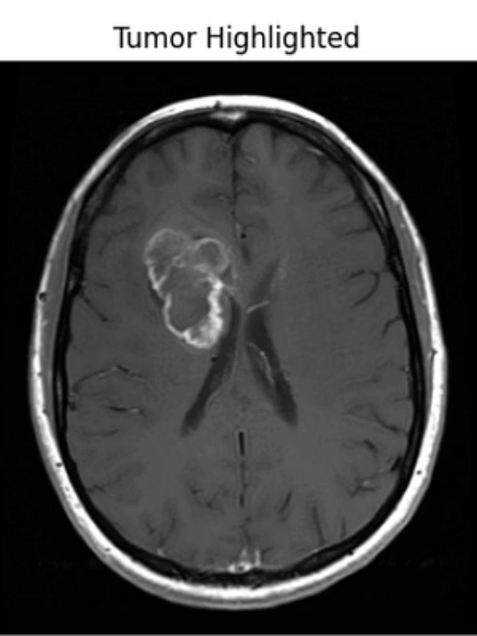
Results & Observations
Visual comparison demonstrates the effectiveness of our segmentation approach across the complete processing pipeline.
From left to right: Original Grayscale MRI | Otsu Thresholded Image | Morphologically Cleaned Mask | Final Tumor Highlighted Output
Otsu's Method Effectiveness
Morphological Refinement
Boundary Detection
Accurately separates tumor regions from surrounding brain tissue using automated threshold optimization.
Opening and closing operations significantly improve mask quality by eliminating noise and enhancing connectivity.
Contour detection effectively visualizes tumor boundaries, enabling precise localization for clinical assessment.

Slide 6
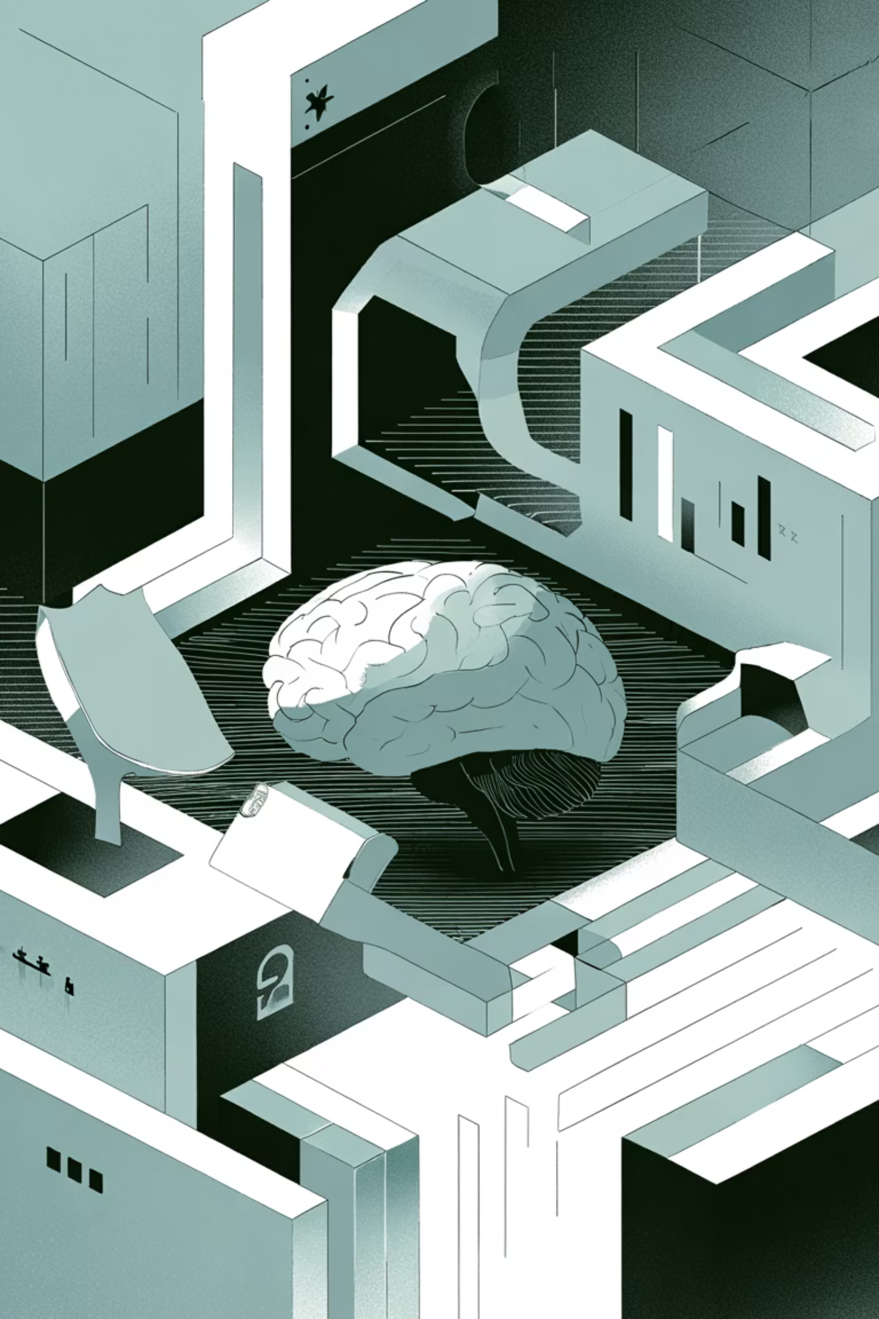
Conclusion & Future Scope
Key Findings
Future Enhancements
This project successfully demonstrates tumor segmentation using classical image processing techniques. Otsu's Thresholding combined with Morphological Operations produced clean, interpretable masks suitable for medical image preprocessing and automated diagnosis systems.
Integrate CNN-based classifiers for automatic diagnosis
Enhance accuracy using adaptive or hybrid thresholding
Implement deep learning for multi-class segmentation
Extend to 3D volumetric tumor analysis
Thank You
SRM Institute of Science and Technology

